Slide 1
Object Oriented Analysis and Object Oriented Design
OO Design

Slide 2
Object-Oriented Design
Traditional procedural systems separate data and procedures, and model these separately
Object orientation combines data and methods together into a cohesive whole
  data abstraction
The purpose of Object-Oriented (OO) design is to define the classes (and their relationships) that are needed to build a system that meets the requirements contained in the SRS
OO Design

Slide 3
OO A&D
OO techniques can be used in analysis (requirements) as well as design
  The methods and notations are similar
In OO analysis we model the problem domain, while in OO design we model the solution domain
Often structures created during OO analysis are subsumed (reused, extended) in the structures produced by OO design
  The line between OO analysis and OO design is blurry, as analysis structures will transition into model elements of the target system
OO Design

Slide 4
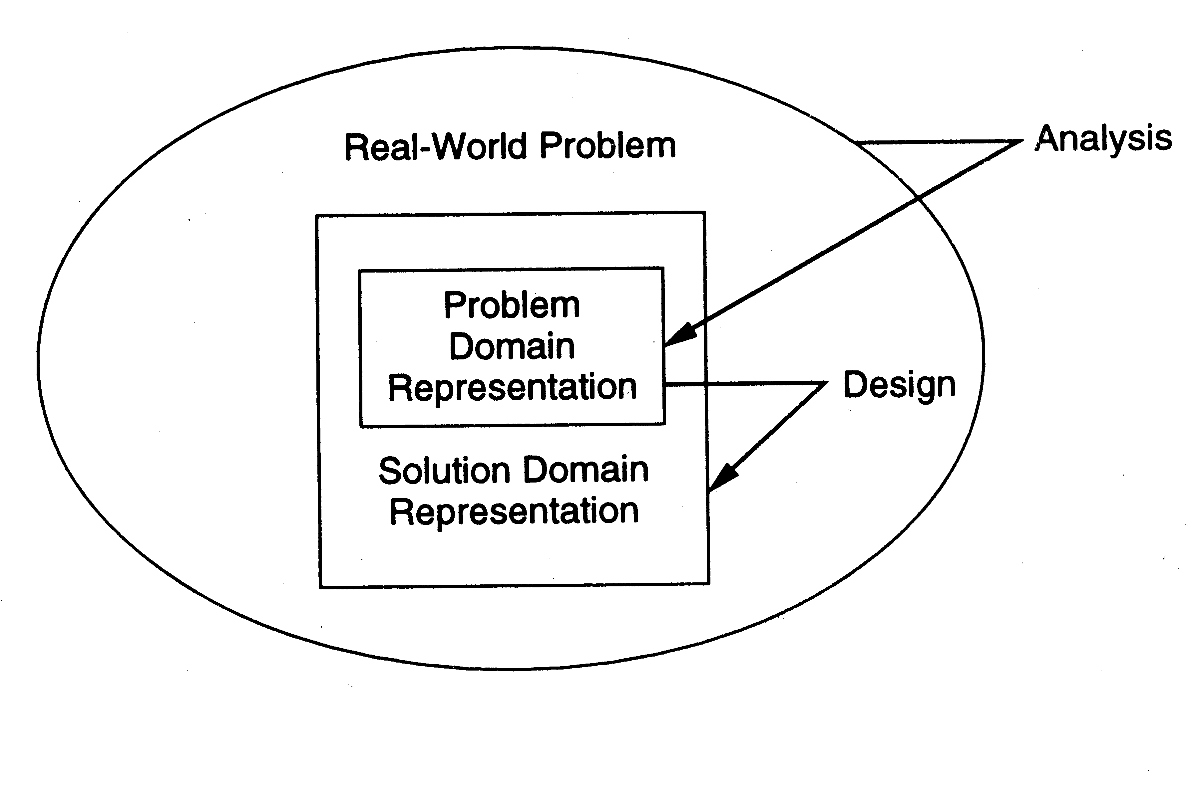
Relationship of OO A&D
OO Design

Slide 5
OO Concepts
Encapsulation
  grouping of related ideas into one unit which we can refer to by a single name
  For example, methods, classes, packages
Provides information hiding by restricting the external visibility of a unit’s information
In OO A&D, the object is the unit of encapsulation
  An object’s data is hidden behind the public interface (methods) of the object
OO Design

Slide 6
OO Concepts…
State Retention
  the functions of function-oriented design do not retain state; an object, on the other hand, is aware of its past and maintains state across method invocations
Identity – each object can be identified and treated as a distinct entity
  very important issue, see lecture 10
Behavior – state and methods together define the behavior of an object, or how an object responds to the messages passed to it
OO Design

Slide 7
OO Concepts..
Classes – a class is a stencil from which objects are created; defines the structure and services of a “class” of objects. A class has
  An interface which defines which parts of an object can be accessed from outside
  A body that implements the operations
  Instance variables to hold object state
Objects and classes are different; a class is a type, an object is an instance
  State and identity is associated with objects
OO Design

Slide 8
OO Concepts – access
Operations in a class can be
  Public: accessible from outside
  Private: accessible only from within the class
  Protected: accessible from within the class and from within subclasses
OO Design

Slide 9
Inheritance
Inheritance is unique to OO and not available in function-oriented languages/models
If class B inherits information from class A, it implicitly acquires the attributes and methods of A
  Attributes and methods of A are reused by B
When B inherits from A, B is the subclass or derived class and A is the base class or superclass
OO Design

Slide 10
Inheritance..
A subclass B generally has a derived part (inherited from A) as well as new attributes (new instance variables or methods)
  B’s specification only defines the new attributes
This creates an “is-a” relationship
  objects of type B are also objects of type A
OO Design

Slide 11
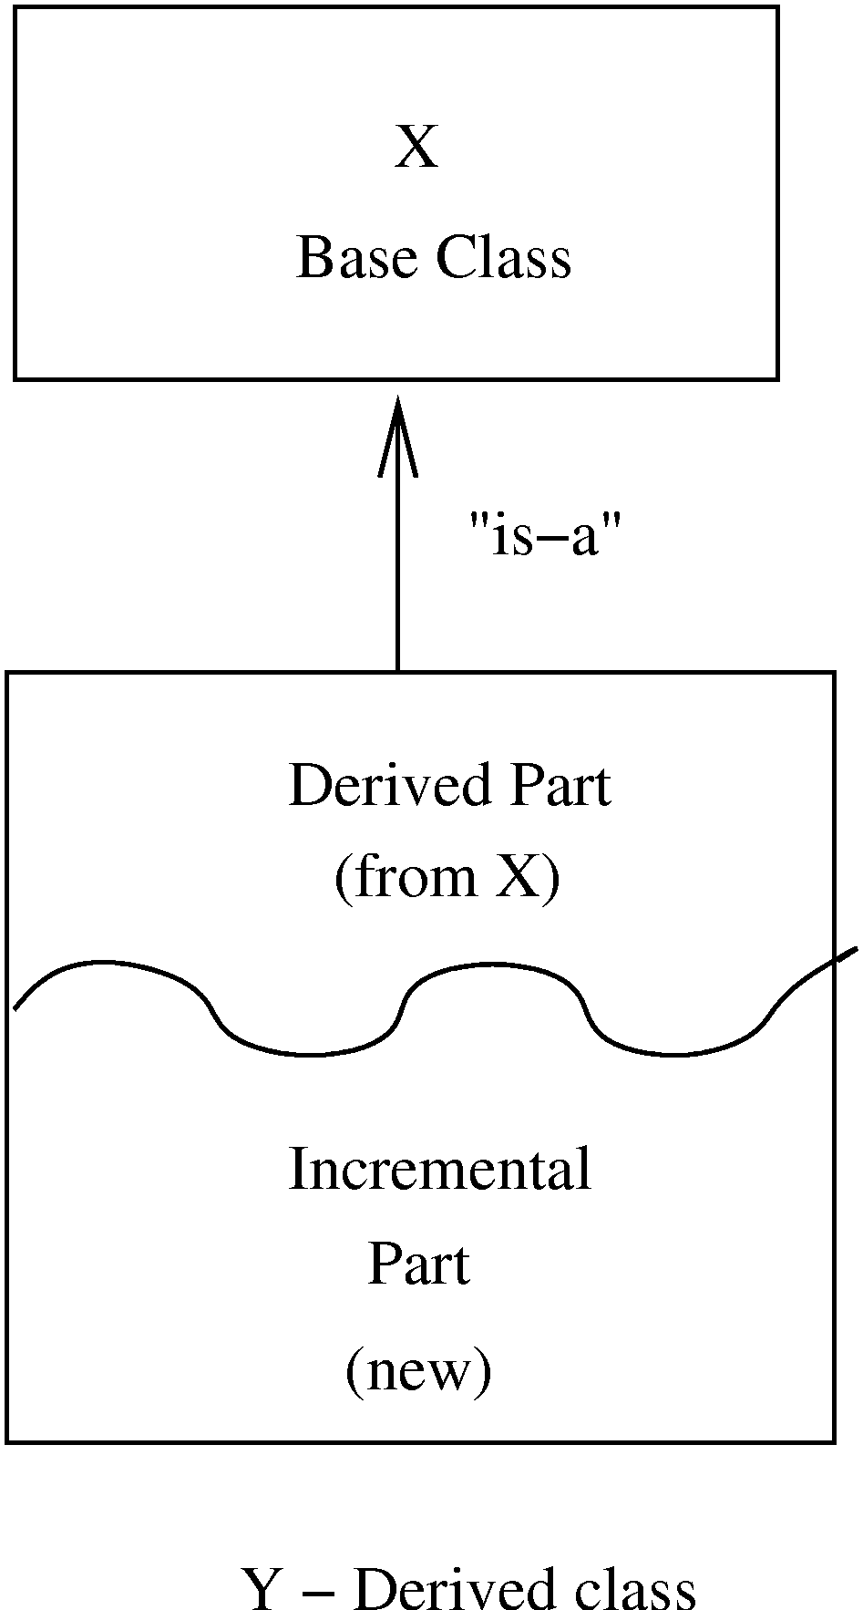
Inheritance…
OO Design

Slide 12
Inheritance…
The inheritance relationship between classes forms a class hierarchy
  In models, hierarchy should represent the natural relationships present in the problem domain
  In a hierarchy, all the common features of a set of objects can be accumulated in a superclass
This relationship is also known as a generalization-specialization relationship
  since subclasses specialize (or extend) the more generic information contained in the superclass
OO Design

Slide 13
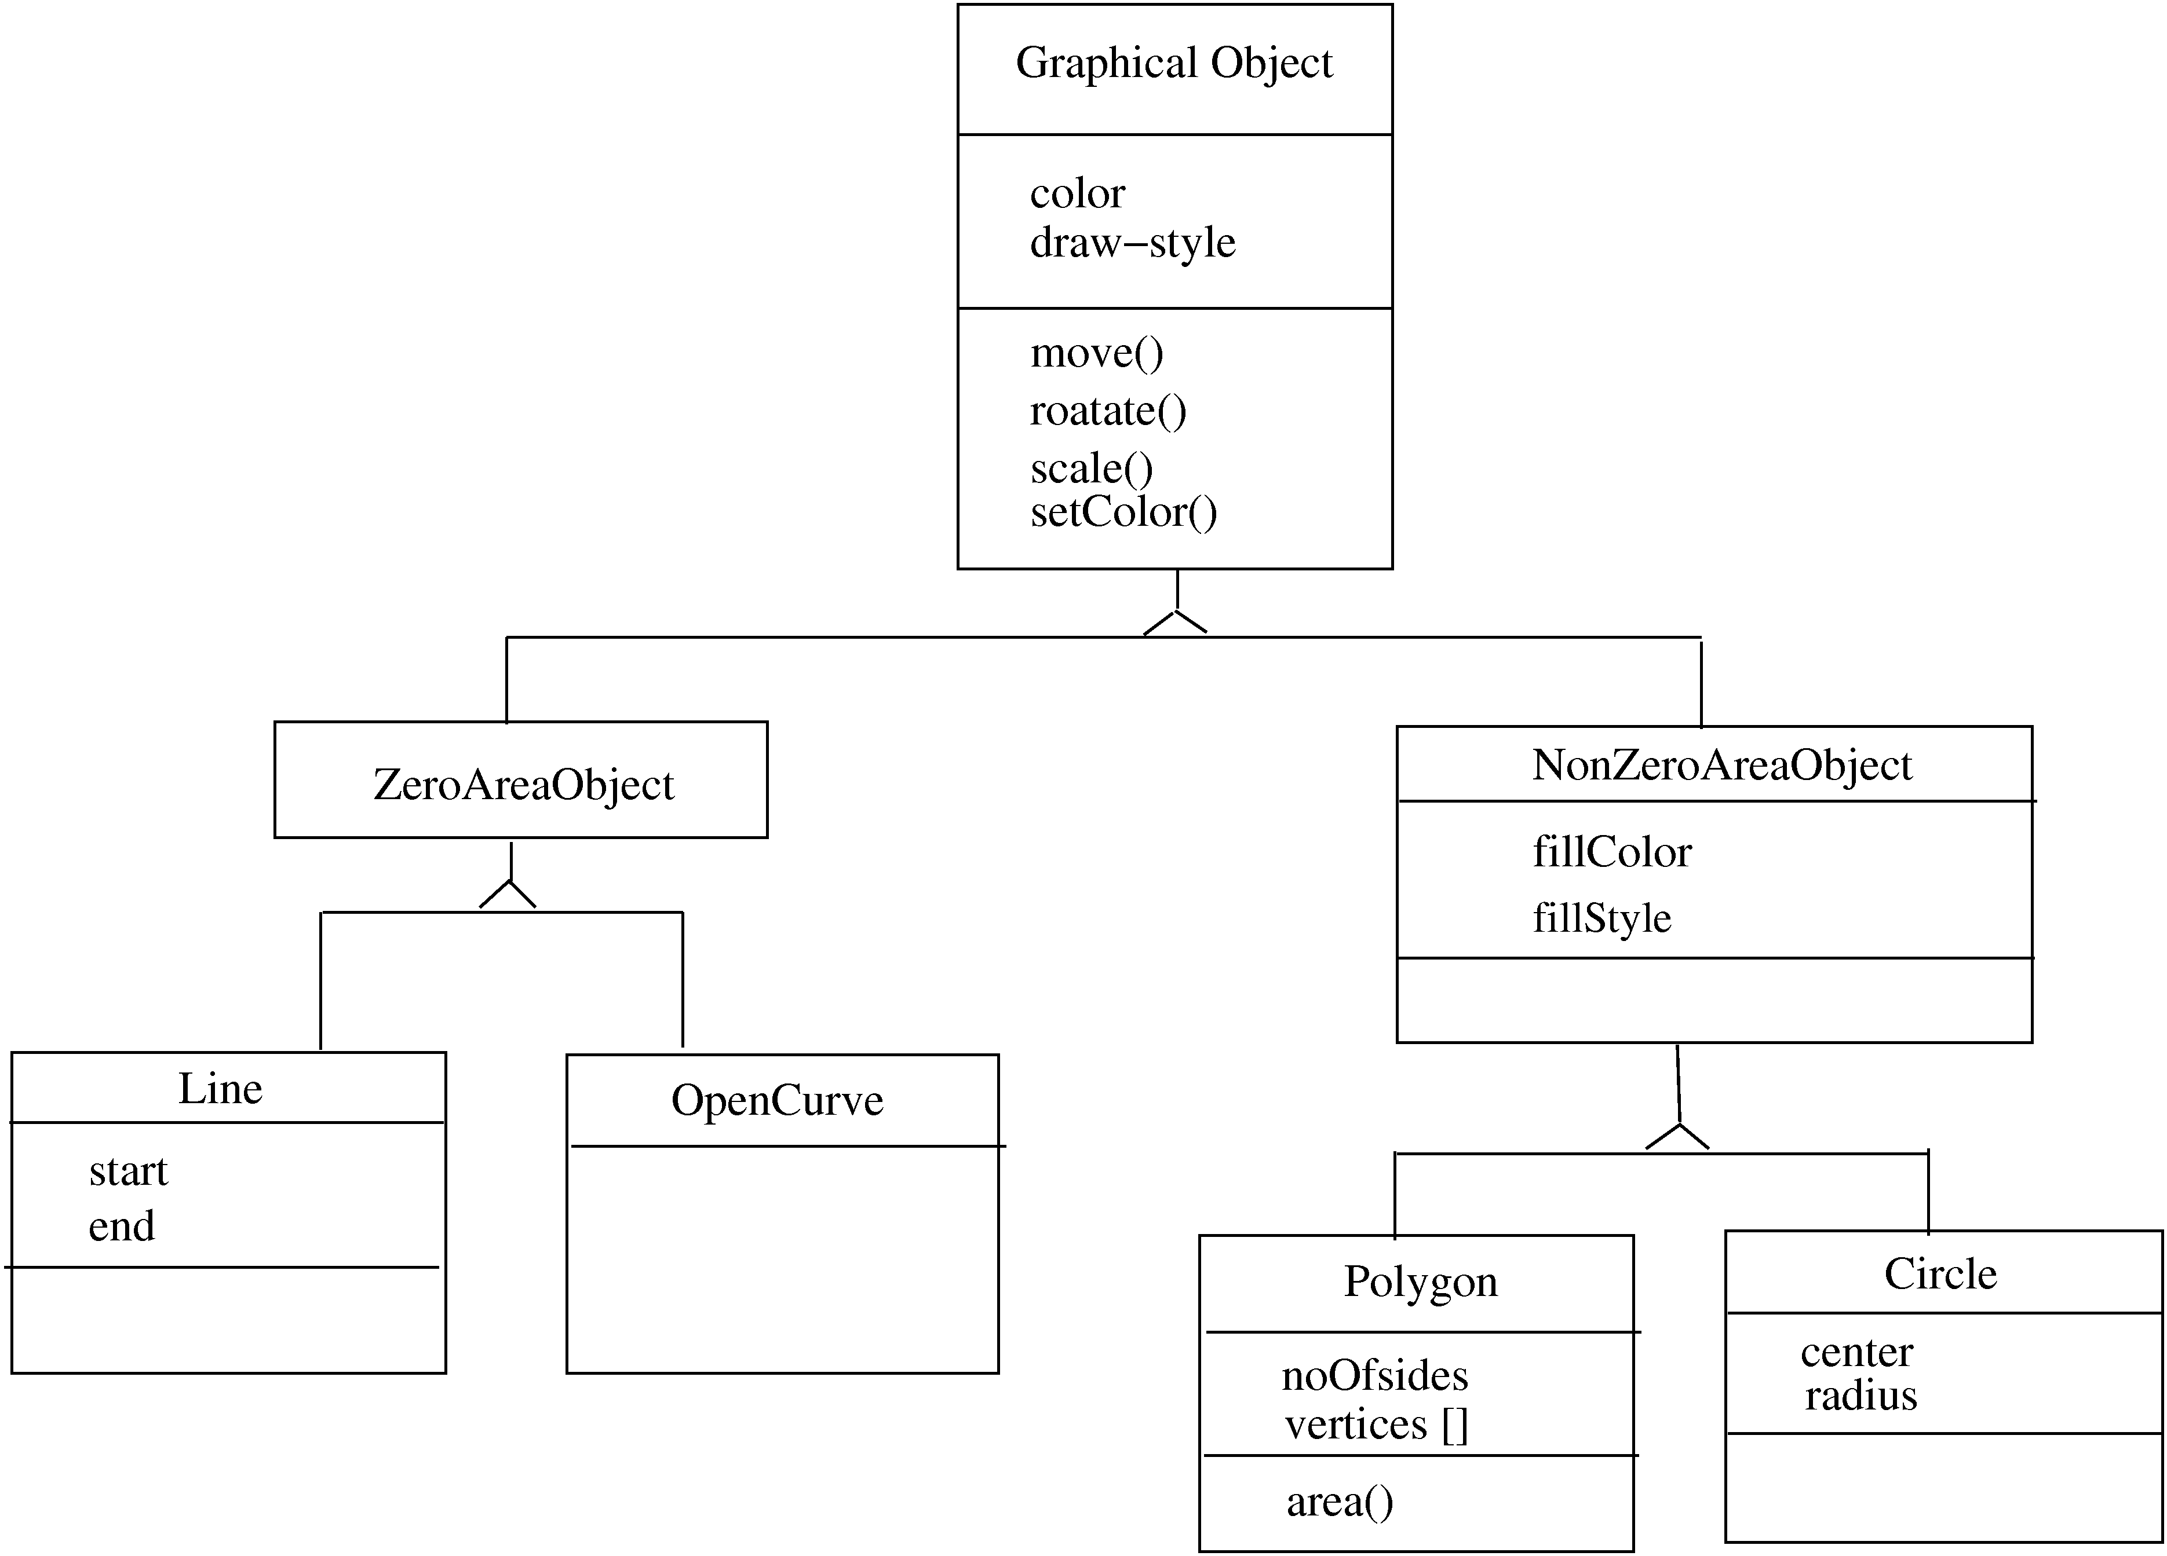
OO Design

Slide 14
Inheritance…
There are several types of inheritance
  Strict inheritance: a subclass uses all of the features of its parent class without modification
    The subclass only adds new attributes or methods
  Non-strict inheritance: a subclass may redefine features of the superclass or ignore features of the superclass
Strict inheritance supports “is-a” cleanly and has fewer side effects
  If a subclass redefines a method of the parent, it can potentially break the contract that the superclass offers its users
OO Design

Slide 15
Inheritance…
Single inheritance – a subclass inherits from only one superclass
  Class hierarchy is a tree
Multiple inheritance – a class inherits from more than one class
  Can cause runtime conflicts
  Repeated inheritance - a class inherits from a class but from two separate paths
OO Design

Slide 16
Inheritance and Polymorphism
Inheritance enables polymorphism, i.e. an object can be of different types
Hence an object has a static type and a dynamic type
  Implications on type checking
  Also brings dynamic binding of operations which allows writing of general code where operations do different things depending on the type
  An object of type B is also an object of type A
OO Design

Slide 17
Module Level Concepts
Basic modules are classes
During OO design, a key activity is to specify the classes in the system being built
In creating our design, we want it to be “correct” (i.e. cover its requirements)
  But a design should also be “good” – efficient, modifiable, stable, …
We can evaluate an OO design using three concepts
  coupling, cohesion, and open-closed principle
OO Design

Slide 18
Coupling
In OO design, three types of coupling exists
  interaction
  component
  inheritance
OO Design

Slide 19
Coupling…
Interaction coupling occurs when the methods of a class invoke methods of another class
  this can’t be avoided, obviously…
  but we want to ensure that an object’s public interface is used
    a method of class A should NOT directly manipulate the attributes of another class B
    Why?
OO Design

Slide 20
Coupling…
Component coupling – when a class A has variables of another class C
  A has instance variables of type C
  A has a method with a parameter of type C
  A has a method with a local variable of type C
When A is coupled with C, it is coupled with all subclasses of C as well
  Component coupling will generally imply the presence of interaction coupling also
OO Design

Slide 21
Coupling…
Inheritance coupling – two classes are coupled if one is a subclass of the other
  again, can’t be avoided, inheritance is a useful and desirable feature of OO approaches
  however, a subclass should strive to only add features (attributes, methods) to its superclass
    as opposed to modifying the features it inherits from its superclass
OO Design

Slide 22
Cohesion
Cohesion is an intramodule concept
Focuses on why elements are together
  Only elements tightly related should exist together in a module (class)
  This gives a module a clear abstraction and makes it easier to understand
Higher cohesion leads to lower coupling as many otherwise interacting elements are already contained in the module
Goal is to have high cohesion in modules
Three types of cohesion in OO design
  method, class, and inheritance
OO Design

Slide 23
Cohesion…
Method cohesion
  A class should attempt to have highly cohesive methods, in which all of the elements within a method body help to implement a clearly specified function
Class cohesion
  A class itself should be cohesive with each of its methods (and attributes) contributing to implement the class’s clearly specified role
OO Design

Slide 24
Cohesion…
Inheritance cohesion – focuses on why classes are together in a hierarchy
  Two reasons for subclassing
    generalization-specialization and reuse
    The former occurs when the classes in the hierarchy are modeling true semantic (“is-a”) relationships found in the problem domain
    The latter sometimes occurs when a pre-existing class does most of what you need but for a different part of the semantic space; the subclass may not participate in an “is-a” relationship; this should be avoided!
OO Design

Slide 25
Open-closed Principle
Principle: Classes should be open for extension but closed for modification
  Behavior can be extended to accommodate new requirements, but existing code is not modified
    allows addition of code, but not modification of existing code
  Minimizes risk of having existing functionality stop working due to changes – a very important consideration while changing code
OO Design

Slide 26
Open-closed Principle…
In OO design, this principle is satisfied by using inheritance and polymorphism
  Inheritance allows creating a new class to extend behavior without changing the original class
  This can be used to support the open-closed principle
  Consider example of a client object which interacts with a printer object for printing
OO Design

Slide 27
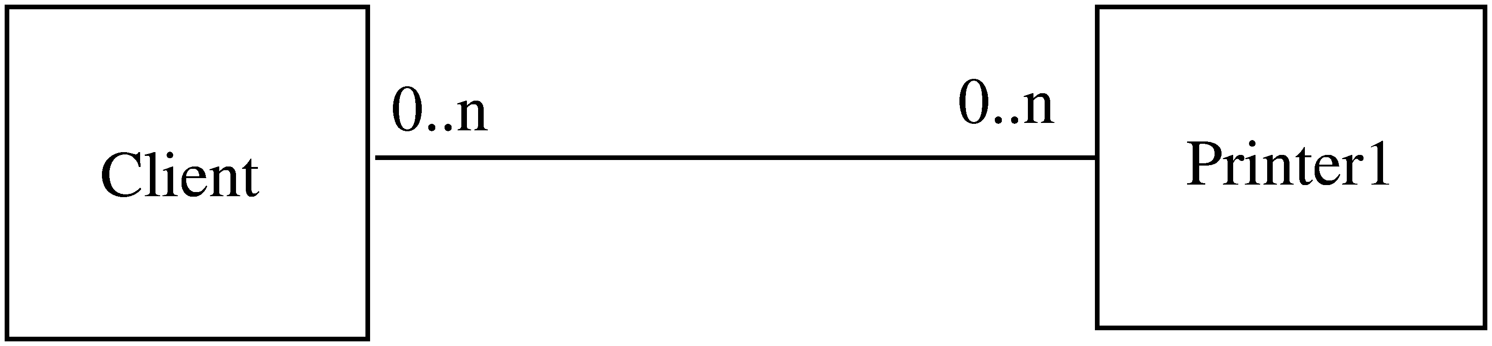
Example
OO Design

Slide 28
Example..
Client directly calls methods on Printer1
If another printer is required
  A new class Printer2 will be created
  But the client will have to be modified if it wants to use this new class
Alternative approach
  Have Printer1 be a subclass of an abstract base class called Printer
  Client is coded to access a variable of type Printer, which is instantiated to be an instance of the Printer1 class
  When Printer2 comes along, it is made a subclass of Printer as well, and the client can use it without modification
OO Design

Slide 29
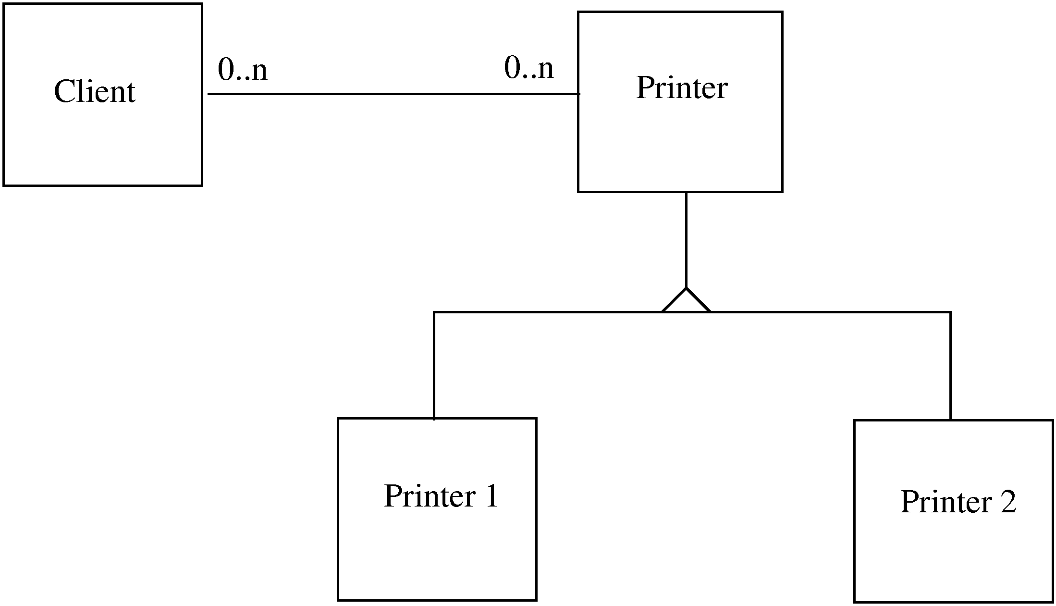
Example…
OO Design

Slide 30
Liskov’s Substitution Principle
Principle: A program using an object o1 of base class C should remain unchanged if o1 is replaced by an object of a subclass of C
  The open-closed principle allows the creation of hierarchies that intrinsically support this principle
OO Design

